Slide 1

Bank Marketing (Campaign)
Group Name: Bank Marketing DS 01
Specialization: Data Science
Team Members: Suvansh Vaid, Ines Perko, Zeynep Basak Eken

Slide 2
Agenda
Executive Summary
Problem Statement
EDA
* Market Analysis
* Analyzing previous campaigns
* Conversion rates
* Economic and Social Indicators
Business Recommendations
Technical Recommendations

Slide 3
Executive Summary
Problem Statement:
ABC Bank wants to sell its term deposit product to customers and before launching the product they want to develop a model which helps them in understanding whether a particular customer will buy their product or not (based on customer's past interaction with bank or other Financial Institution).
Objective:
The Bank wants to shortlist customers whose chances of buying the product are more so that their marketing channel (telemarketing, SMS/email marketing etc) can focus only on those customers. This will save their resource and their time (which is directly involved in the cost (resource billing).
Success Criteria:
The success criteria for this business problem would be based on how much maximum number of customers we are able to predict who have subscribed to the product.

Slide 4
Exploring Data
The given input dataset has 41188 rows and 21 columns (attributes). There are 10 categorical features and 10 numerical features, excluding the output variable y which denotes whether a client subscribed a term deposit or not.
The input data is neatly divided into 4 main categories:
Bank client data; such as age, job, marital status, etc.
Information related to last contact of current campaign; such as duration, day_of_week, etc.
Other attributes; such as previous contacts, campaign, etc.
Social and economic context attributes; such as employment variation rate, etc.
The data is ready for further analysis after inspecting, cleaning and dealing with outliers.

Slide 5
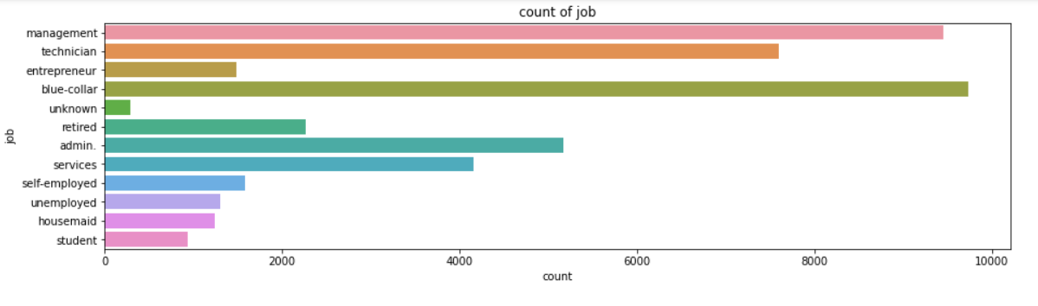
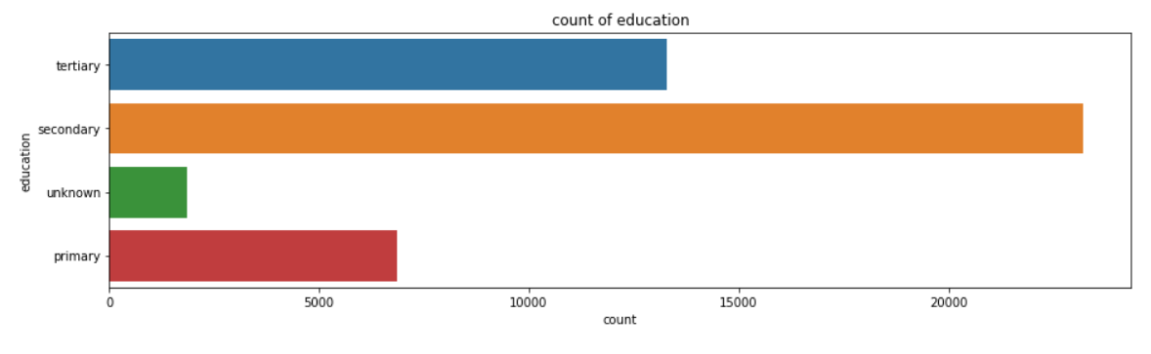
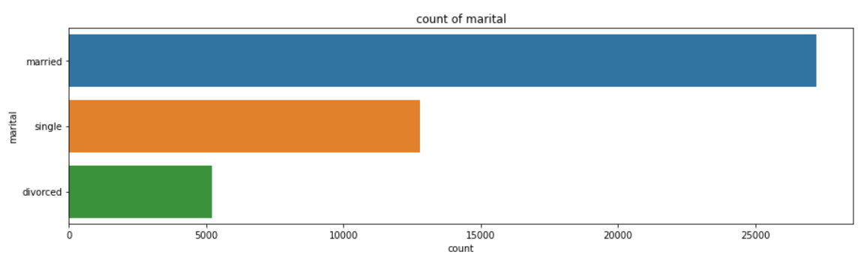
Market analysis
The first step is to get an insight into the clients.
Most clients work in the areas: blue-collar, management, technician and admin, while the least clients work as a housemaid, or are students, or are unemployed.
Most clients are married. The data about educational background is higher when it comes to a secondary degree.

Slide 6
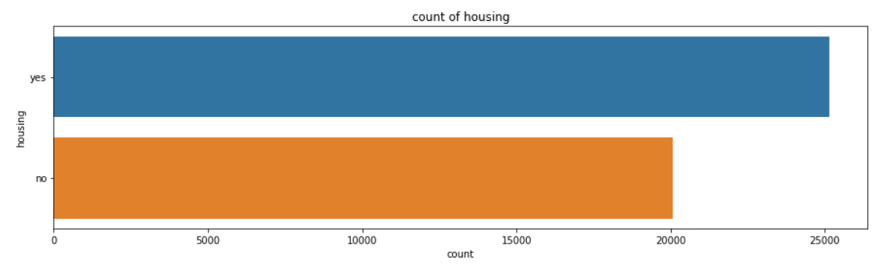
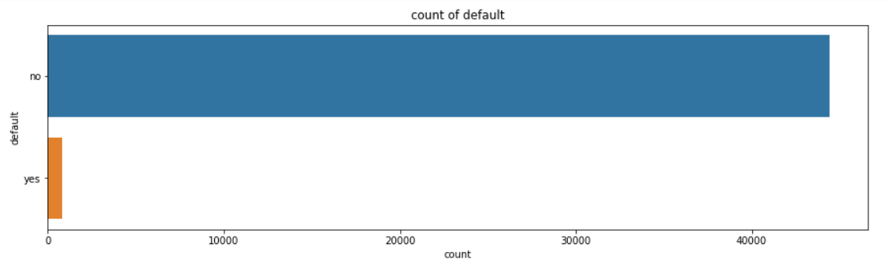
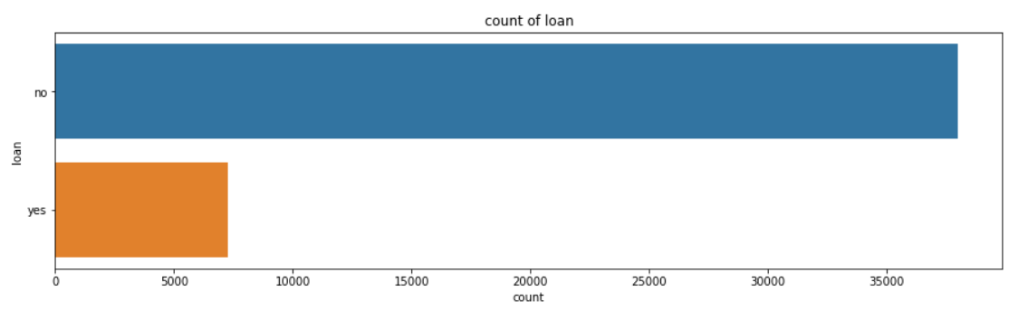
Market Analysis (continued..)
Most of the clients don't have credit in default, or personal loans, but they have housing loans.

Slide 7
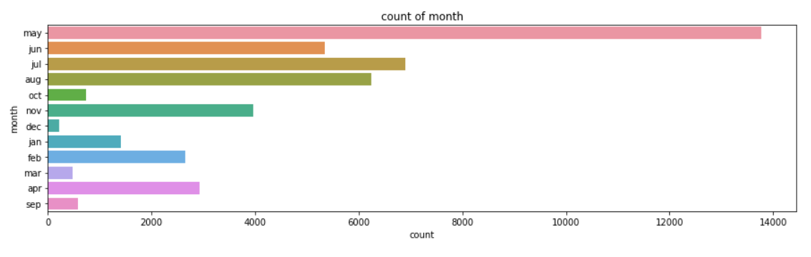
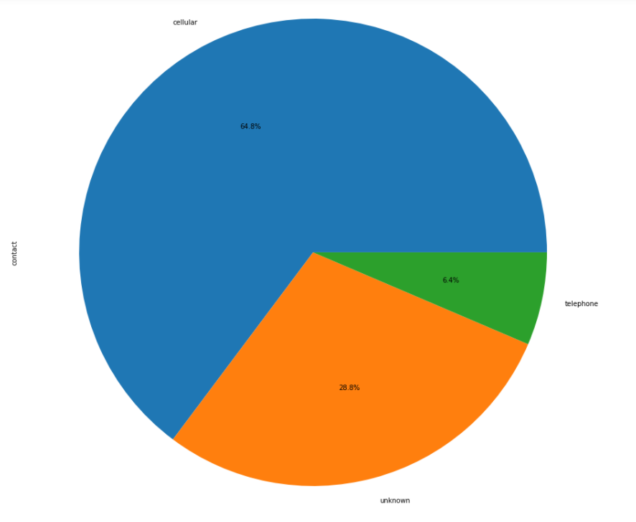
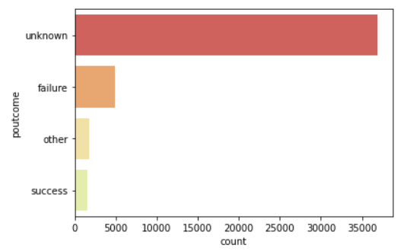
Analyzing Previous Campaigns
Data related with the last contact of the current campaign says the following: The most clients were contacted by cellphone, and most of them were contacted during May.
As number of days passed since the client was contacted from a previous campaign (pdays) seems to be around 0. The outcome of the previous marketing campaign is mostly unknown.

Slide 8
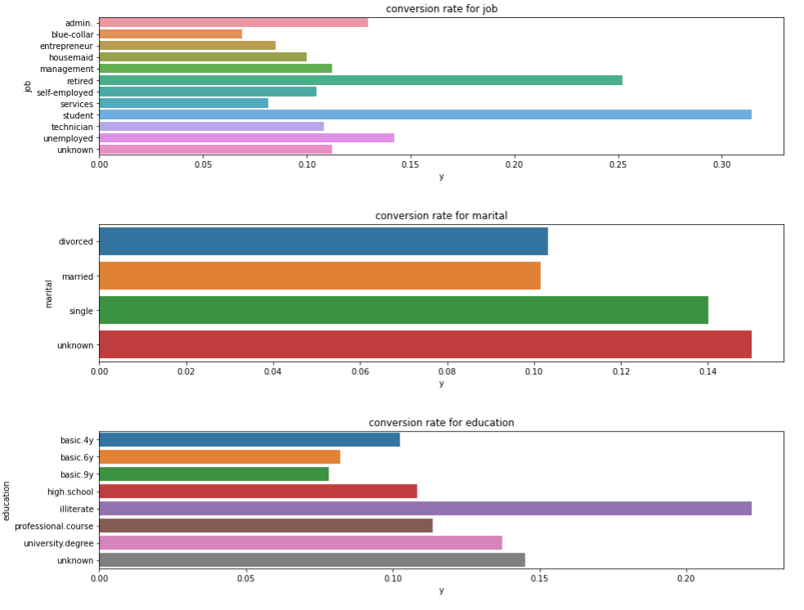
Conversion rates
Key insights:
Retired and student clients had the highest conversion rate.
Clients with occupations of Blue-collar, entrepreneur, service, housemaid and service had low conversion rate.
Married clients are less likely to open a deposit
Greater the level of education, higher the likelihood of conversion was

Slide 9
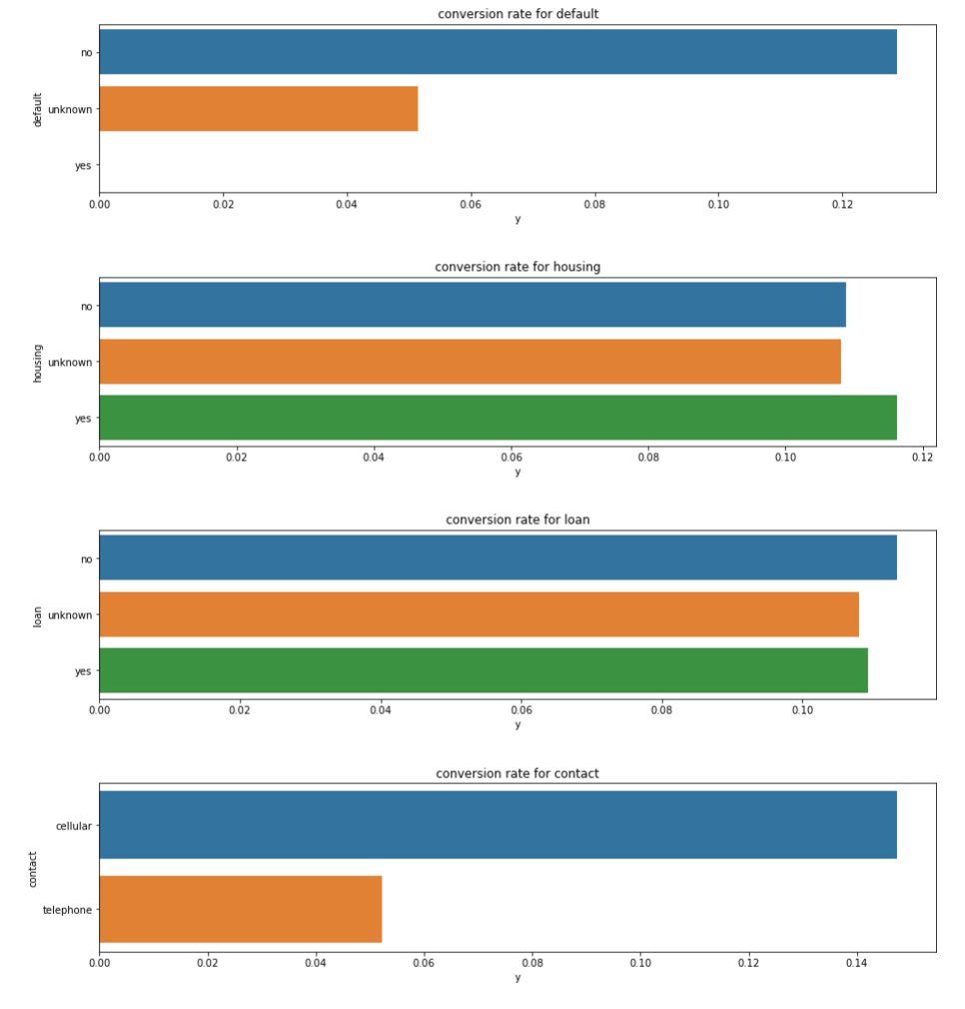
Conversion rates (continued..)
Key Insights:
Those with default experiences are less likely to have money in hand that they are comfortable 'locking up' for few months/years
Ones with any kind of loans had lower conversion rate
Clients contacted with 'cellular' phone have higher chance of conversion than those contacted with ‘telephone’.

Slide 10
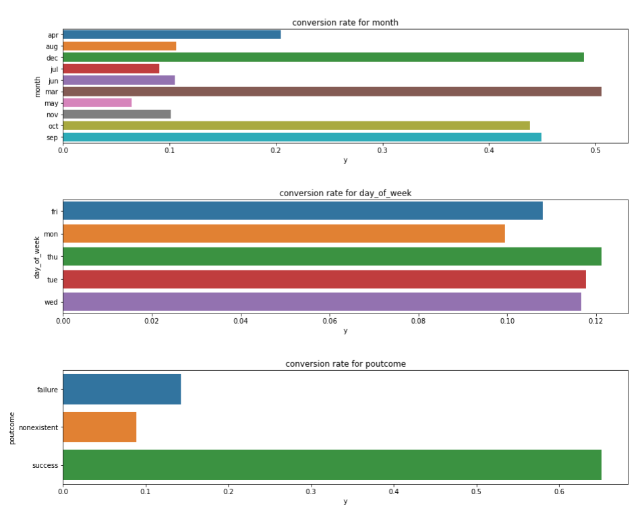
Conversion rates (continued..)
Key Insights:
month of March, September and October had the higher conversion rate than other months.
Previous success in marketing campaign results in higher conversion rate that is statistically significant enough.

Slide 11
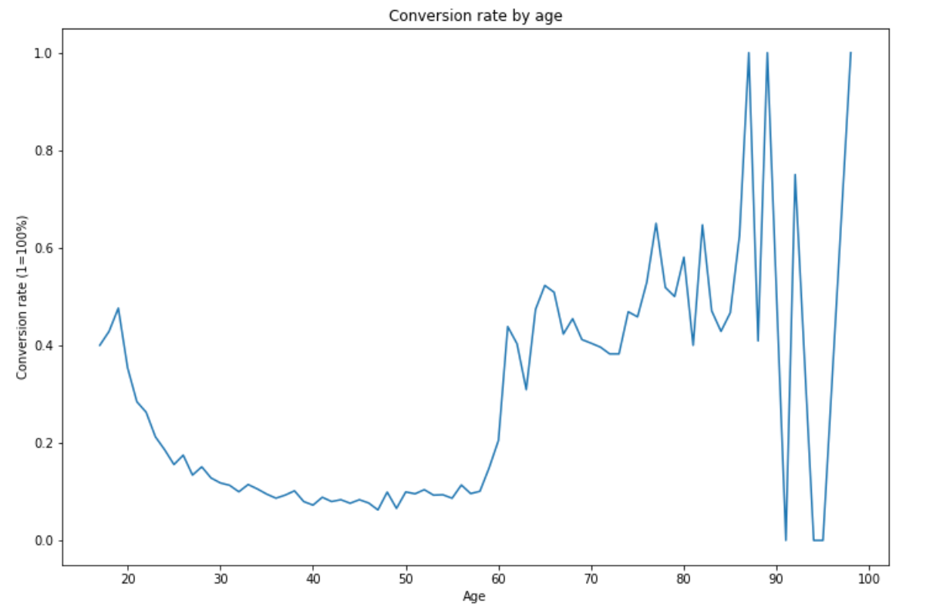
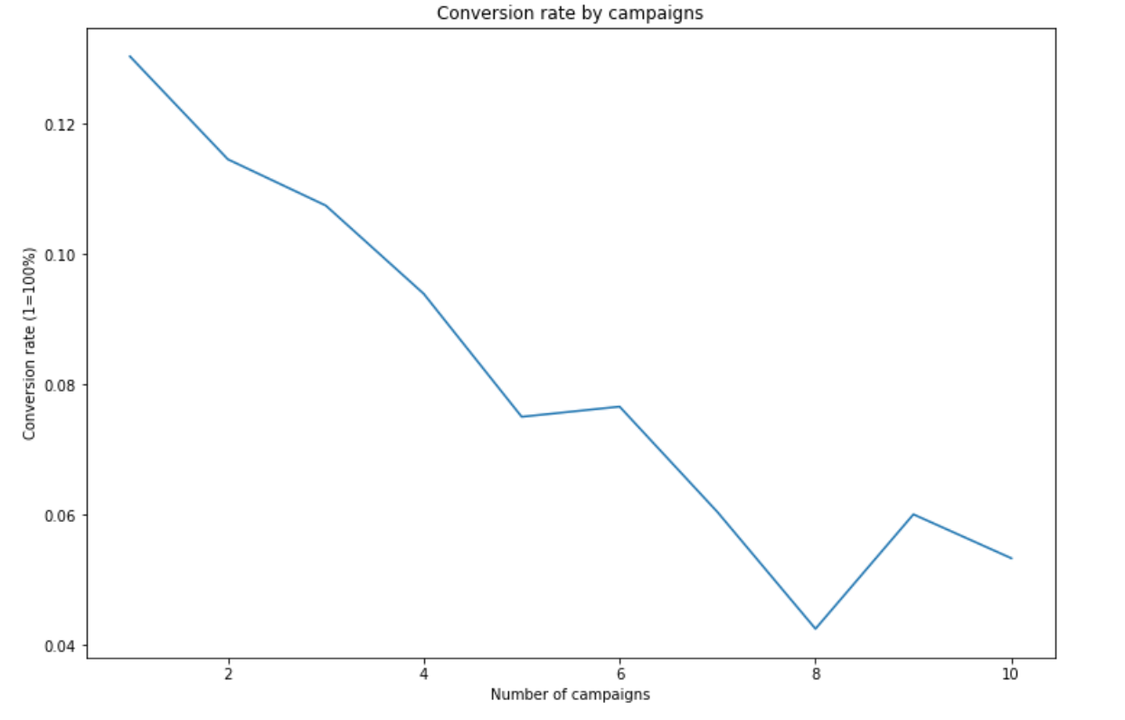
Conversion rates (continued..)
Key Insight:
Those under 30 and over 60 are much more likely to open a deposit from this marketing campaign
Key Insight:
Additional contacts beyond the first diminishes the conversion rate

Slide 12
Economic and Social Indicators
emp.var.rate
Employment variation rate, quarterly indicator
Percentage change in employment from one quarter to another
A lower absolute value of this rate is more desirable, since it indicates more stability and predictability
emp.var.rate
mean | 0.081886
std | 1.57096
min | -3.4
max | 1.4
nr.employed
quarterly average of the total number of employed citizens
euribor3m
Daily three-month Euribor rate
The benchmark interest rate at which major global banks lend to one another
A higher Euribor rate may make deposit options of the bank more attractive to customers(????)

Slide 13
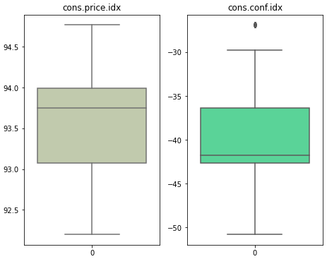
Economic and Social Indicators
cons.price.idx
Measures changes in the price level of a weighted average market basket of consumer goods and services purchased by households
With higher CPI, paying off debt may become more convenient. Thus, one may expect defaults to be lower
One may also expect to observe higher spending with higher CPI
cons.conf.idx
Consumer confidence index, monthly average
Indicator of future developments of households’ consumption and saving
Based upon answers regarding their expected financial situation, their sentiment about the general economic situation, unemployment and capability of savings
Similar to the CPI, individuals with higher CCI may be prone to spending more
cons.price.idx
mean | 93.57566437
std | 0.578840049
min | 92.201
max | 94.767
cons.conf.idx
mean | -40.50260027
std | 4.628197856
min | -50.8
max | -26.9

Slide 14
Business Recommendations
Based on the extensive analysis done above, the following are some of the business recommendations to follow in order to increase the number of client depositors:
Focus on students, retired and unemployed audience since they have the highest conversion rates.
Pick single persons for the marketing campaigns.
Focus mainly on illiterate students. Other than that, target the highly educated population since more education usually means more liquidity.
Mainly focus on cellular campaigns rather than telephonic ones.
Focus the marketing campaigns on the customers with low default history and no previous loans.
Target the months of September, October, December, March and April for the marketing campaigns.
Focus the campaign on two age groups - below 30 and above 60.
Limit the number of contacts per customer to 3.

Slide 15
Technical Recommendations
Based on the data exploration, the following are some recommendations for the technical user:
The variable `duration` must be excluded as it is impractical. Excluding it will lead to a more real world and robust model.
Since the data is highly imbalanced, it must be first balanced using SMOTE (Synthetic Minority Oversampling Technique).
Since this is a pure classification problem , it is recommended to first train some basic interpretable models such as Logistic Regression and Decision trees.
After some basic models, it is recommended to train state of the art classification models using cross validated Random forest classifiers or Gradient Boosting classifiers.
To evaluate the models, it is recommended to not only focus on accuracy but also on other metrics such as precision, recall, F-1 score, etc.

Slide 16
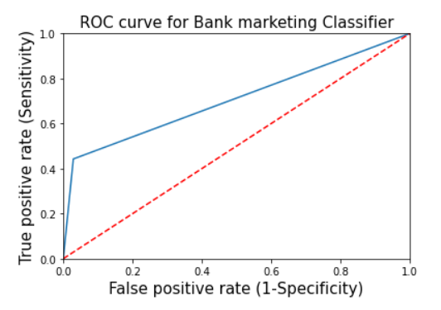
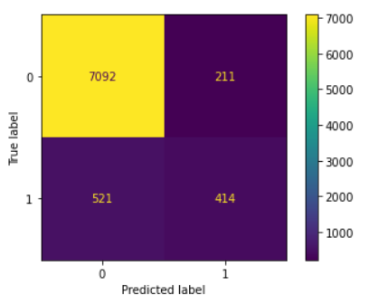
Model building and testing
The following models were implemented and their performance is measured with a ROC curve. The prediction results are summarized in a confusion matrix.
Logistic Regression

Slide 17
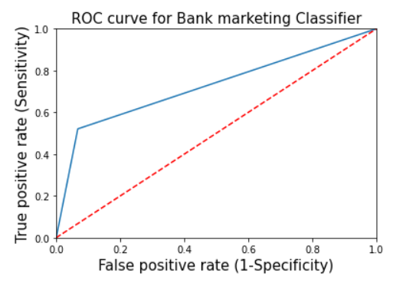
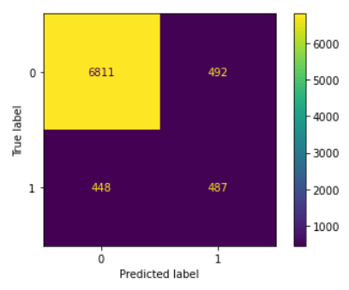
Model building and testing
2. Decision Tree Classifier

Slide 18
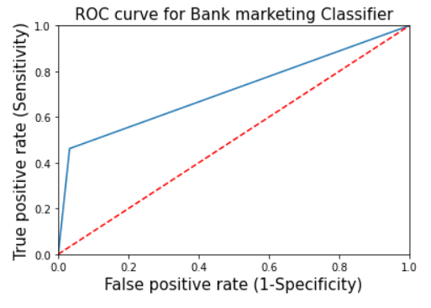

Model building and testing
3. Random Forest Classifier (Bagging)

Slide 19
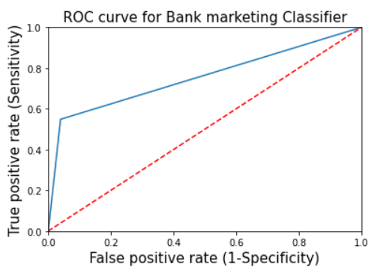

Model building and testing
4. Extreme Gradient Boosting Classifier (Boosting)

Slide 20
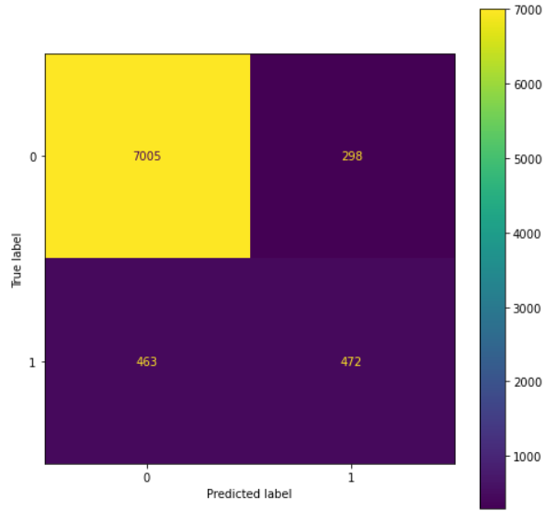
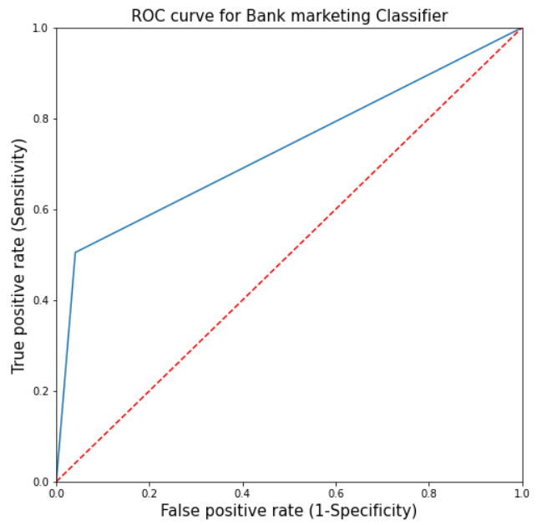
Model building and testing
5. Random Forest on SMOTE sampled data

Slide 21
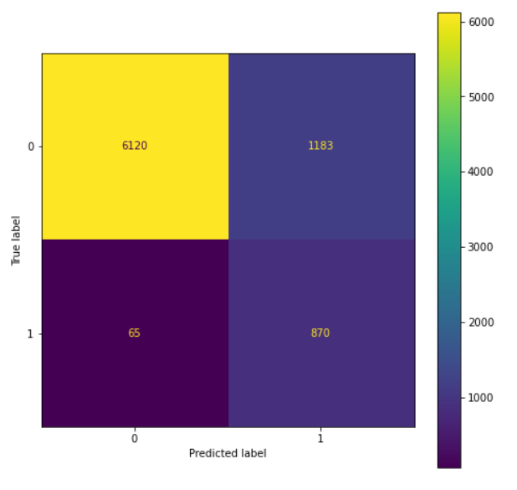
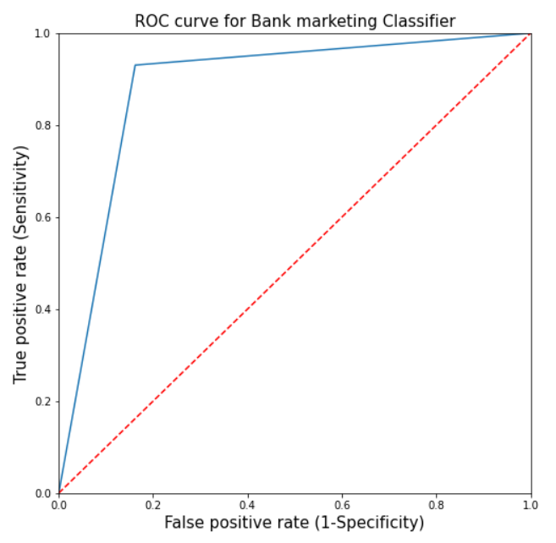
Model building and testing
6. Random Forest on Under Sampled data

Slide 22
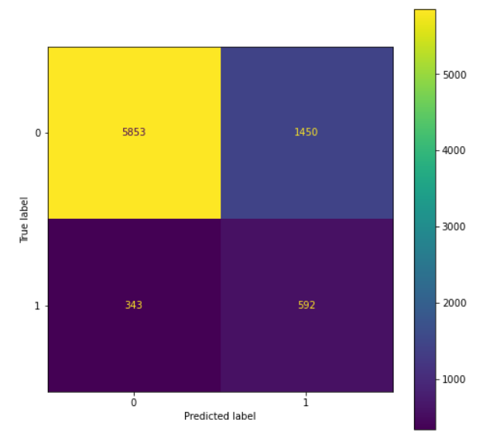
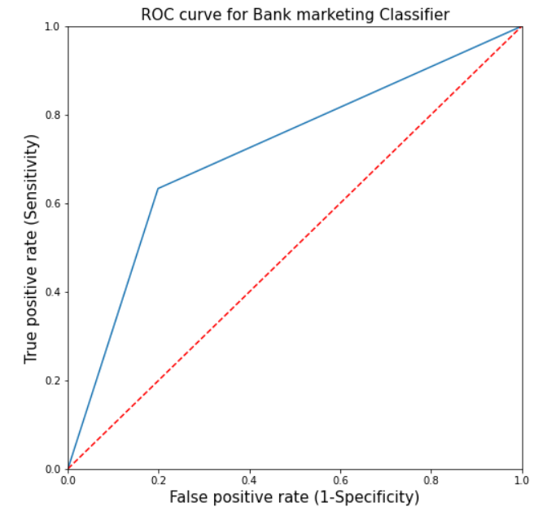
Model building and testing
7. Model without duration and with under sampled data

Slide 23
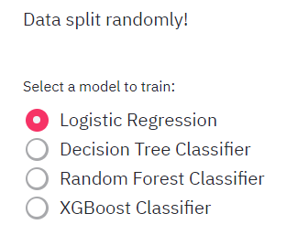
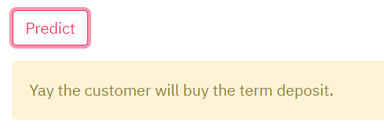
Model building and testing
Models can be tested on https://share.streamlit.io/suvanshvaid27/bank-marketing/main/app.py .The outcome, i.e., the decision of the client to subscribe to a term deposit, is predicted.

Slide 24
Thank You

